Slide 1
GloBox A/B Test Analysis
Testing New Banner for GloBox
Neha Varshney 2023

Slide 2


Slide 3
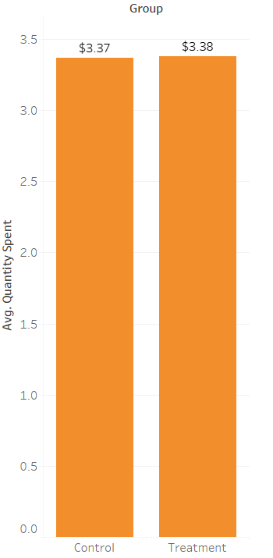
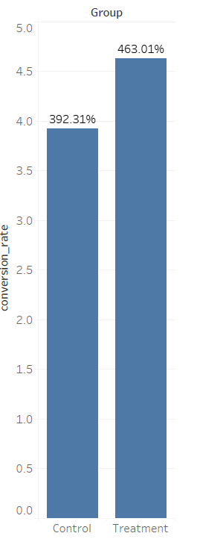
Increase in Conversion rate but not average amount spent
average amount spent
conversion rate
*Statistical significant helps quantify whether a result is likely due to chance or to some factor of interest.
*Statistical insignificant helps to conclude that the uplift in the results is very likely only the result of natural variance.
+0.2%
not enough evidence to conclude a difference
(statistically insignificant)
+18%
strong evidence to conclude a difference
(statistically significant)

Slide 4
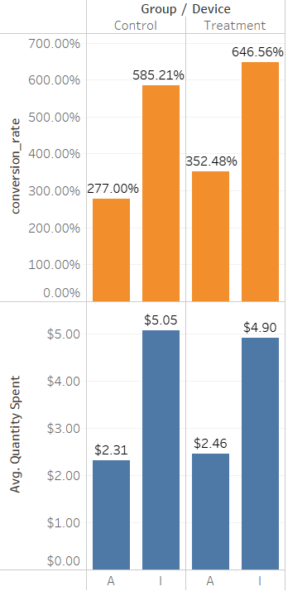
Results By Device
iOS had a higher increase in conversion rate
Android increased by +27%
iOS increased by +10%
Both are flat on average amount spent.

Slide 5
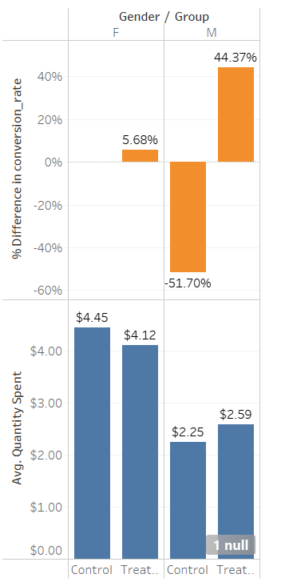
Results By Gender
Male users had a higher increase in conversion rate
Male users conversion rate increased by +44%
Female users conversion rate increased by +6%
Other users conversion rate decreased by -6% but few users

Slide 6
Recommendation: do not launch ×
Launch criteria: 10% lift in both metrics
conversion rate: +18% (significant)
Average amount spent: +0.5% (insignificant)
did not reach desired sample size to sufficiently detect a 10% change
if we continue to iterate, we need to run a larger experiment.

Slide 7
Thank you

